Slide 1
Learning Extrapolating
Representations
Patrick Kuiper – USMA West Point
Ali Hasan – Morgan Stanley
Jose Blanchet – Stanford University
Vahid Tarokh – Duke University
EVA 2025 Presentation: 27 June 2025

Slide 2

Agenda
Problem Overview
$φ−$Stable Operator
Latent Factorization
Inference
Algorithms and Results
Notes:
We will start with an overview of a problem from a practical perspective, then build into a proposed algorithm and results .
I think I have 5 slides of content, so I’ll try to keep things moving so we can all travel home safely and enjoy our afternoon and the cool weather.

Slide 3
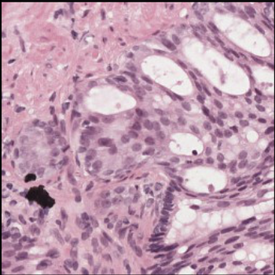
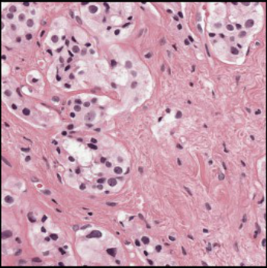
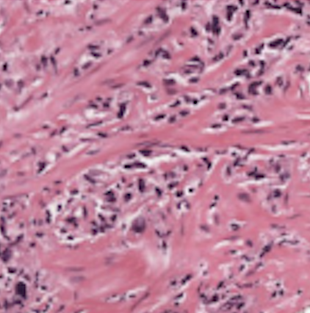
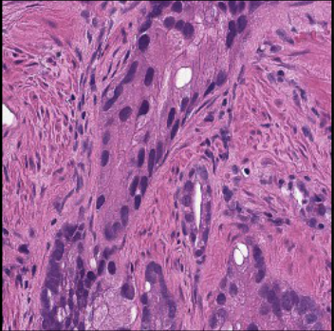
Extrapolation Learning Example
Pathologists have more examples of normal relative to diseased medical images, with fewer images available as severity increases.
Disease severity, labeled as 𝜉, exists in a different domain from the image data 𝑋.
Understanding this distribution could help extrapolate to rare and unseen cases.
This approach would be useful for pathologist training and treatment planning.
Notes:
We will now begin our discussion concerning extrapolating learned representations.
To motivate our proposal, we consider characterizing the distribution of abnormal pathologies in medical imaging.
In the example pictured here, we have prostate tissue samples, which pathologists use to diagnose cancer severity.
The severity is quantified by a metric called a gleason score.
Pathologists often have some examples of normal medical images with decreasing numbers of diseased cases as a function of severity.
Here we define disease severity with the label $ξ$ (zai) for image data $X$.
We note that disease severity, in this case is quantified categorically with integers between 1-5, and the image data exist in completely different domains.

Slide 4


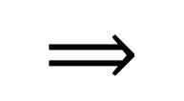
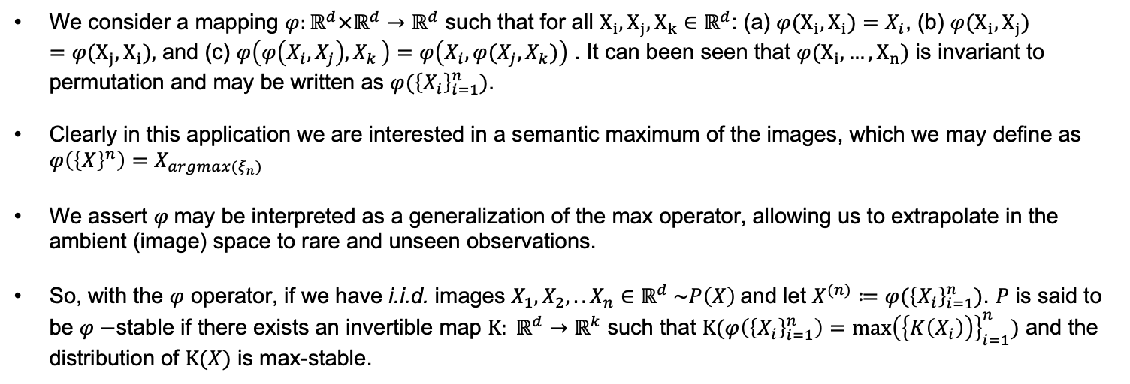
Introducing $φ−$Stable Operator
$$⟹$$
$$φ$$
We consider a mapping $φ:ℝ^{d}×ℝ^{d}→ℝ^{d}$ such that for all $X_{i}, X_{j}, X_{k}∈ℝ^{d}$: (a) ${φ(X}_{i}, X_{i})=X_{i}$, (b) ${φ(X}_{i}, X_{j})={φ(X}_{j}, X_{i}),$ and (c) $φ\left(φ\left(X_{i},X_{j}\right){,X}_{k}\right)=φ\left({X_{i},φ(X_{j},X}_{k})\right)$ . It can been seen that ${φ(X}_{i},…, X_{n})$ is invariant to permutation and may be written as $φ({\left\{X_{i}\right\}}_{i=1}^{n})$.
Clearly in this application we are interested in a semantic maximum of the images, which we may define as $φ\left({\left\{X\right\}}^{n}\right)=X_{argmax(ξ_{n})}$
We assert $φ$may be interpreted as a generalization of the max operator, allowing us to extrapolate in the ambient (image) space to rare and unseen observations.
So, with the $φ$ operator, if we have i.i.d. images $X_{1}, X_{2},.. X_{n}∈ℝ^{d} \sim P\left(X\right)$and let $X^{(n)}≔φ({\left\{X_{i}\right\}}_{i=1}^{n})$. $P$ is said to be $φ−$stable if there exists an invertible map $K: ℝ^{d}→ℝ^{k}$ such that $K(φ\left({\left\{X_{i}\right\}}_{i=1}^{n}\right)={\max\left(\left\{K\left(X_{i}\right)\right)\right\}}_{i=1}^{n})$ and the distribution of $K(X)$ is max-stable.
Notes:
We propose it would be of immense utility – for example to complete pathologist training or treatment planning - to extrapolate to rare and potentially unseen images based upon disease severity.
How can we achieve this extrapolation? We do this by introducing the abstract concept of the phi$−$stable operator.
Really in the example of these cancer images we have a ”max in disguise” and the Phi operator allows us to access this disguised max.
Here the phi$−$stable operator is a max taken over the label or context of the image data.
Specifically, we would like to ensure that there is a consistency between an encoding of the phi$−$stable operator applied to image data and the max of the encoded values, where the $φ−$stable operator applied to image data understands the context – such as cancer severity - which is not inherent to the magnitude of the actual observed image pixel values.

Slide 5


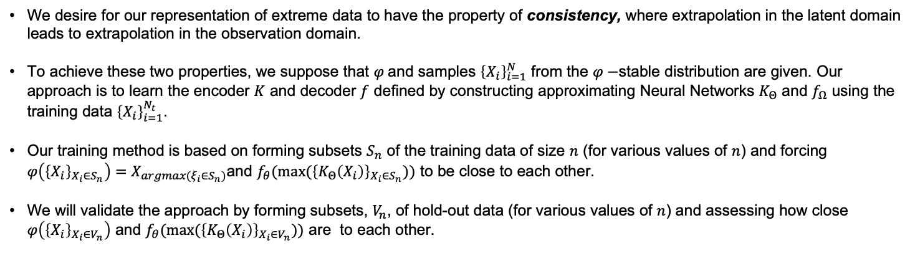












Latent Factorization using Neural Network
We desire for our representation of extreme data to have the property of consistency, where extrapolation in the latent domain leads to extrapolation in the observation domain.
To achieve these two properties, we suppose that $φ$and samples ${\left\{X_{i}\right\}}_{i=1}^{N}$ from the $φ−$stable distribution are given. Our approach is to learn the encoder $K$ and decoder $f$ defined by constructing approximating Neural Networks $K_{Θ}$ and $f_{Ω}$ using the training data ${\left\{X_{i}\right\}}_{i=1}^{N_{t}}$.
Our training method is based on forming subsets $S_{n}$ of the training data of size $n$ (for various values of $n$) and forcing $φ\left({\left\{X_{i}\right\}}_{X_{i}∈S_{n}}\right)=X_{argmax(ξ_{i}∈S_{n})}$and $f_{θ}(max⁡({\left\{K_{Θ}\left(X_{i}\right)\right\}}_{X_{i}∈S_{n}}))$ to be close to each other.
We will validate the approach by forming subsets, $V_{n}$, of hold-out data (for various values of $n$) and assessing how close $φ\left({\left\{X_{i}\right\}}_{X_{i}∈V_{n}}\right)$ and $f_{θ}(max⁡({\left\{K_{Θ}\left(X_{i}\right)\right\}}_{X_{i}∈V_{n}}))$ are to each other.
$$z_{0}$$
$$K_{Θ}$$
$$⟹$$
$$max$$
$$⟹$$
$$z_{1}$$
$$⟹$$
$$⋮$$
$$⋮$$
Random Block Sizes and Max Recorded
$$X_{i}∈S_{n}$$
Encoded
$$max⁡({\left\{K_{Θ}\left(X_{i}\right)\right\}}_{X_{i}∈S_{n}}$$
L$atent$
Factors
$$⋮$$
$$z_{n}$$
Notes:
So how do we create a phi stable operator in practice?
Overall, our goal is to ensure that extrapolation in the latent domain leads to consistent extrapolation in observations.
We will use the max over latent representation of the images as a proxy for the proposed phi-stable operator.
To do this we first formulate an encoder and a decoder using approximating neural networks trained on observed samples from the bulk of the image distribution.
Training is conducted by forming subsets or blocks of data and enforcing consistency between extrapolated values in both the max in the latent and true max observation domains, relative to a context of the image - such as disease severity.
The approach is validated using hold-out data, with a more extreme context, to assess the closeness of the predicted versus actual extrapolated images.

Slide 6



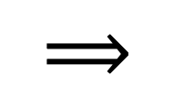


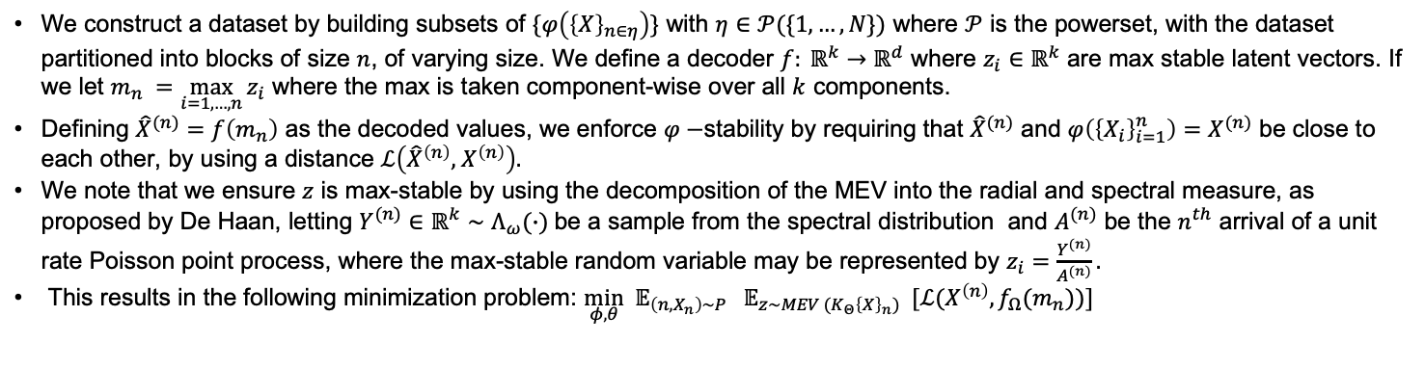

Inference Procedure for the $φ−Stable$ Operator
$$⟹$$
$$⟹$$
Encoding:
$$K\left(X_{i}\right)=z_{i}$$
Extrapolation:
f$\left(∨_{i=1}^{n}z_{i}\right)={\hat{X}}^{(n)}$
Max stable factors:
$$z∼MEV (K\left(X\right))$$
Out of distribution data:
$$X^{(n)}=φ\{X_{1}, X_{2},…, X_{n}\}$$
Data available: $\{X_{1}, X_{2}, …,X_{n}\}$
We construct a dataset by building subsets of $\{φ\left({\left\{X\right\}}_{n∈η}\right)\}$ with $η∈𝒫(\{1, …, N\})$ where $𝒫$ is the powerset, with the dataset partitioned into blocks of size $n$, of varying size. We define a decoder $f: ℝ^{k}→ℝ^{d}$ where $z_{i}∈ℝ^{k}$ are max stable latent vectors. If we let $m_{n} =\max_{i=1, …, n}{z_{i}}$ where the max is taken component-wise over all $k$ components.
Defining ${\hat{X}}^{(n)}=f\left(m_{n}\right)$ as the decoded values, we enforce $φ−$stability by requiring that ${\hat{X}}^{(n)}$ and $φ\left({\left\{X_{i}\right\}}_{i=1}^{n}\right)=X^{(n)}$ be close to each other, by using a distance $ℒ\left({\hat{X}}^{\left(n\right)},{ X}^{\left(n\right)}\right).$
We note that we ensure $z$ is max-stable by using the decomposition of the MEV into the radial and spectral measure, as proposed by De Haan, letting $Y^{(n)}∈ℝ^{k}∼Λ_{ω}(∙)$be a sample from the spectral distribution and $A^{(n)}$ be the $n^{th}$ arrival of a unit rate Poisson point process, where the max-stable random variable may be represented by $z_{i}=\frac{Y^{(n)}}{A^{(n)}}.$
This results in the following minimization problem: $\min_{φ,θ} 𝔼_{\left(n, X_{n}\right)\sim P} 𝔼_{z\sim MEV (K_{Θ}{\left\{X\right\}}_{n})} [ℒ(X^{\left(n\right)}, f_{Ω}(m_{n}))]$
Notes:
We may now ask, how is the extrapolation completed in the latent domain?
To accomplish all of this we must reference the concept of max-stability.
We begin by recording the true max image observations relative to a context, $ξ.$
To enforce phi$−$stability, the difference between max image decoded by $f_{Ω}$ and the corresponding batch’s true max image is minimized using a distance function.
The distribution of the latent variables, is ensured to be from an MEV during the training process by using the De Haan’s decomposition.
Here the output of the approximating encoder neural networks $K_{Θ}$ are taken as the spectral components, which are then scaled by the radial components, sampled from a unit rate Poisson point process.
In summary we have formulated an expectation-based minimization problem to optimize the encoder $K_{Θ}$ and decoder $f_{Ω}$, ensuring the MEV characterization in the latent domain.
A decoder function $f$ maps latent vectors $z_{i}$ from $ℝ^{k}$ to decoded values ${\hat{X}}^{(n)}$ in $ℝ^{d}$
The max-stable latent vector $m_{n}$ is defined as the component-wise maximum of $z_{i}.$

Slide 7
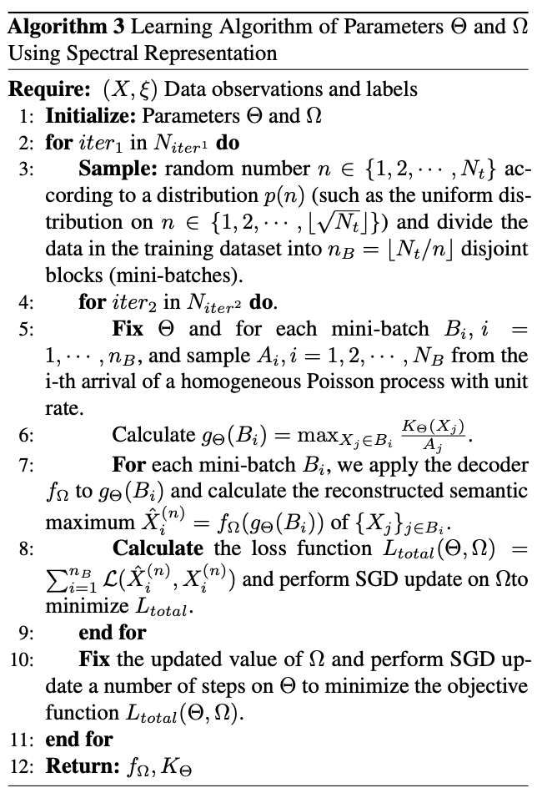
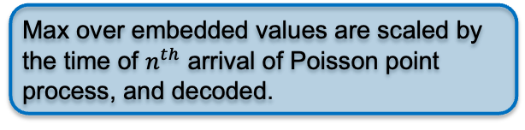
Algorithm to Train the Encoder and Decoder
Data is organized into features / labels, where labels are the context for extremes.
Separate data into random block sizes for each batch.
Max over embedded values are scaled by the time of $n^{th}$ arrival of Poisson point process, and decoded.
Calculate the loss between semantic and reconstructed maximum, then update model
Notes:
We now present a consolidation of what we have discussed into a training regime for the approximating encoding and decoding neural networks.
We start with partitioning the data into random block-sizes for each training batch.
The true max for each block in the batch is identified and recorded for reference in the loss function. Then the data is encoded and scaled by the radial component.
A max is taken of the latent scaled data, which is then decoded and compared to the original ambient max for the respective block.
The encoder and decoder neural networks are updated accordingly.

Slide 8
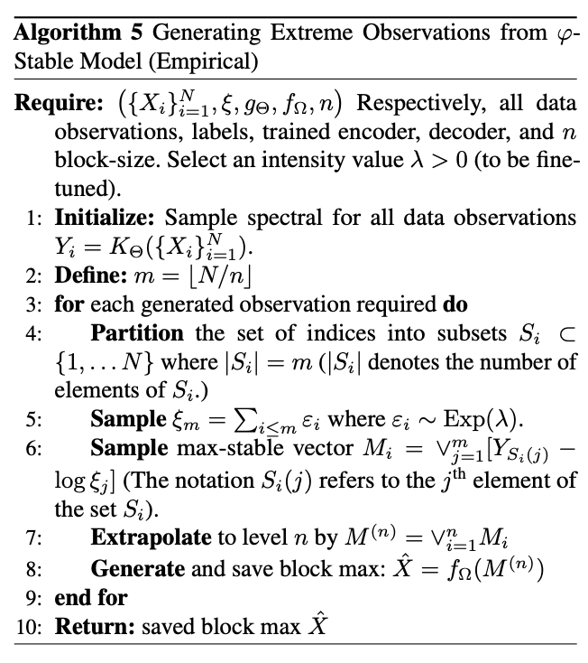
Algorithm to Generate from the Encoder and Decoder
Data is organized into features / labels, where labels are the context for extremes.
Encode all existing data for generation purpose
Separated encoded existing data into blocks, where blocksize controls extremeness
Generate observations of Poisson point process, scale the encoded data according to the spectral decomposition, take max, and decode.
Notes:
For sampling, specifically for the spectral representation approach, we encode all of the data using the trained encoder, K.
The data is partitioned over a pre-defined block size and scaled according to a unit rate Poisson point process as during training.
A max is taken over the scaled data, then the max is decoded using the trained decoder network.

Slide 9
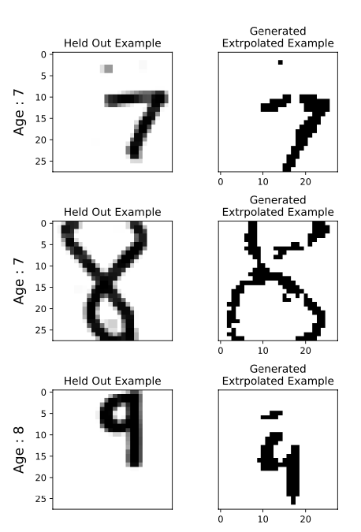
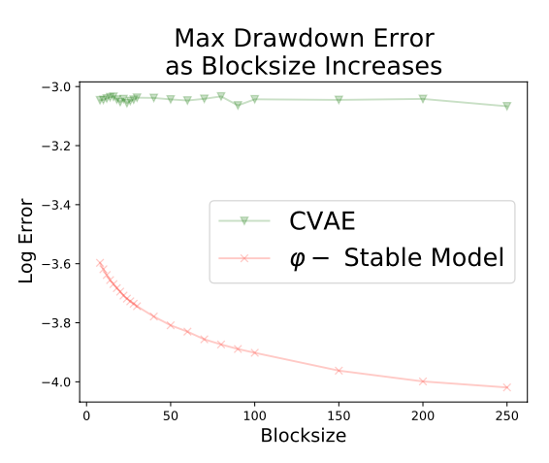
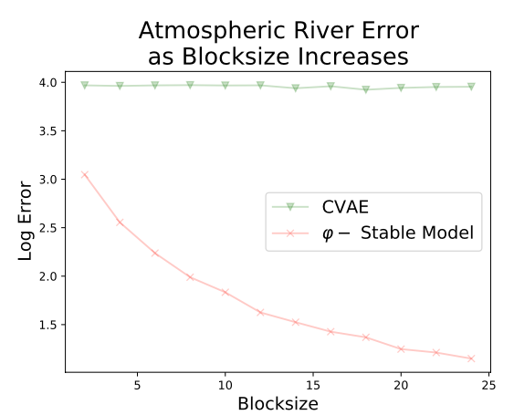
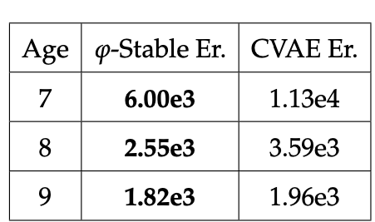
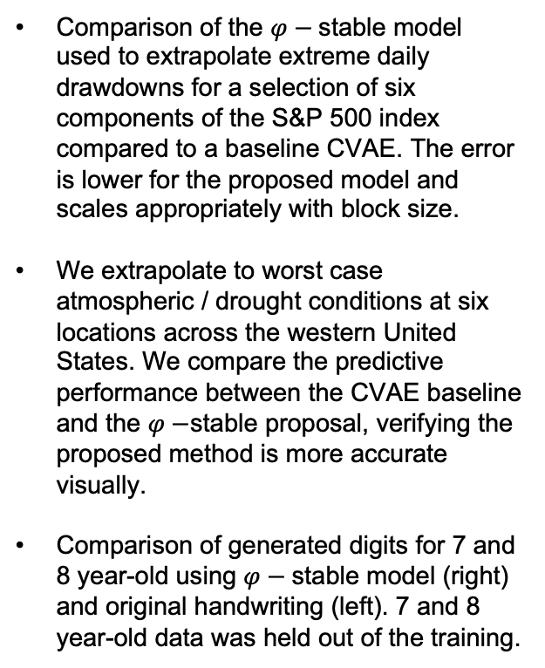
Application Experiments
Comparison of the $φ−$stable model used to extrapolate extreme daily drawdowns for a selection of six components of the S&P 500 index compared to a baseline CVAE. The error is lower for the proposed model and scales appropriately with block size.
We extrapolate to worst case atmospheric / drought conditions at six locations across the western United States. We compare the predictive performance between the CVAE baseline and the $φ−$stable proposal, verifying the proposed method is more accurate visually.
Comparison of generated digits for 7 and 8 year-old using $φ−$stable model (right) and original handwriting (left). 7 and 8 year-old data was held out of the training.
Validation Error
Notes:
We now evaluate how is this useful on real data with a practical application?
In this slide we have provided several examples of real data applications and compared to a CVAE baseline.
Starting from the top right, we plot data of daily changes of 6 blue chip components of the sp500 that have been listed for 60 years. This experiment answers the question of how bad could a worst-case daily stock drop – or drawdown - be for each of these 6 blue chip stocks.
We demonstrate extrapolating to worst case drawdown risks, by training on block sizes of 1-4 weeks length, then extrapolating to the max for much longer block lengths, ranging from 8-250 weeks. We see that as the validation block lengths continues to grow, the $phi−$stable model error continues to improve relative to the CVAE baseline.
This experiment is demonstrating consistency of the trained neural network to represent worst case drawdown scenarios over much larger block sizes of 8-250 weeks versus those the model was exposed to of 1-4 weeks.
Here we see this consistency exists, were the$φ−$stable network is able to represent the maxes with decreasing error over increasing block sizes, as expected. We see the CVAE does not demonstrate this behavior.
Moving down we present a very similar experiment for integrated water vaper measurements, which are indicators of the presence of atmospheric rivers in the western united states. This experiment answers the question of how bad could drought conditions in the west be, over some specified amount of time.
We see visually with this heatmap the ability of the $phi−$stable model to extrapolate to worst case or 80-year drought conditions accurately at each of the locations, relative to the worst-case conditions anticipated by the CVAE baseline.
Finally, in an experiment similar to the disease pathology example, we use a data set of MNIST digits where the writers age, for each digit written is recorded.
Here we trained the $phi−$stable model with digits written by people 12 years and older and attempt to extrapolate to younger, 7, 8, and 9 year old children’s handwritten digits.
A table is presented of validation error for reconstructing young children’s writing, which was completely held out based upon age, along with randomly generated images of younger children’s writing.
We see the validation error beating the CVAE baseline for the youngest children’s writing and we demonstrate the qualitative reasonableness of the generated images.

Slide 10
Thank You!
Questions?
Notes:
Again, thank you very much to my advisors and committee members.
I am standing by for any questions.

Slide 11


Preliminary for Extreme Value Theory
Single Variable GEV (Fisher and Tippet [1928], and Gnedenko [1943])
$$M_{n}=max\{X^{(1)}, …, X^{\left(n\right)} \} , with X^{\left(i\right)}∈ℝ in i=1, …, n$$
$$P\left(a_{n}^{−1}\left(M_{n}−b_{n}\right)≤x\right)=P\left(M_{n}≤a_{n}x+b_{n}\right)=Π_{i=1}^{n}P\left(M_{i}≤a_{i}x+b_{i}\right)=F_{n}\left(a_{n}x+b_{n}\right)→G\left(x\right) as n→∞$$
Multivariable Variable GEV
$$\{X^{(1)}, …, X^{\left(n\right)} \} , with X^{\left(i\right)}∈ℝ in i=1, …, n$$
$$M_{k,n}≔\max_{i=1,…,n}{X_{k}^{(i)}, where k∈\{1, …, d\}}$$
$P\left(\frac{M_{1,n}−b_{1, n}}{a_{1,n}}≤z_{1},…,\frac{M_{d,n}−b_{d, n}}{a_{d,n}}≤z_{d}\right)→G\left(z_{1},…,z_{d}\right) where a_{k,n}>0 and b_{k,n} as n→∞$
Spectral Decomposition (De Haan [1984])
Risk Calculations
$$M\left(x\right)=\max_{i=1,..,n}{ξ^{\left(i\right)}Y}^{\left(i\right)}\left(x\right),$$
$$M\left(x\right)≔max stable process,M∈ℝ^{d}$$
$$VaR_{p}\left(X\right)=F^{←}\left(p\right)=\inf{\{x}:P\{X≤x\}≥p\}$$
$$CVaR\left(p\right)=𝔼[X|X>VaR_{p}]$$
$$Y^{(i)}≔dependence \left(Y^{\left(i\right)}\sim H\left(∙\right)\right)and Y^{\left(i\right)}∈∆_{d−1}$$
$$p≔threshold, ∈[0, 1]$$
$$ξ^{\left(i\right)}≔ith arrival time$$
$\left(ξ^{\left(i\right)}\sim Poisson\left(λ=1\right)\right)and ξ^{\left(i\right)}∈ℝ$
$$F^{←} ≔quantile function$$
Notes:
To begin our discussion we must introduce preliminary definitions provided on this slide.
We begin by defining the development of the Generalized Extreme Value distribution G for the single variate case, where G is the distributional limit when the max or min operator is applied to uniform divisions, or blocks, of data.
Blocks of data, for example, could be the max daily rainfall over a month time period, where the month of data is the block length.
Naturally there are many examples where the GEV should be extended to multiple variables such as a portfolio of securities, or extreme weather at different locations, and we provide the natural extension to the multivariate case below the first block.
Here the component wise maximas are taken across a number of covariates d. Now we may consider max-daily rainfall at a number of spatial locations, for example .
In order to allow for the non-parametric formulation of more flexible multivariate max-stable distributions, we introduce an alternative characterization of the MEV leveraging a Poisson point process.
With this representation, max-stable distributions are now decomposed according to the radial /xi (zai) and spectral components, Y(x) . Specifically, if we let Y(i) be distributed according to a spectral distribution H and \xi be the time component of the ith arrival of a unit rate poisson point process, then a max-stable random variable may be represented as shown.
Intuitively /xi accounts for the extremeness of data, and Y for the dependent structure between covariates.
Now additionally, in the applications we present, we consider both Value at Risk and Conditional Value at Risk as important statistics of interest. Value at Risk or VaR is a statistical metric used to estimate the potential maximum loss over a specific time horizon at a predefined confidence level.
In simpler terms, VaR can tell you the worst-case scenario within a certain timeframe and probability.
Conditional Value at Risk (CVaR) tells you the average loss you expect to experience if the VaR threshold is crossed or the average loss in the worst-case scenarios.
Here \xi computationally is the cumulative sum of a set of random variables.

Slide 12
Selected References
Blanchet, J., & Murthy, K. (2019). Quantifying distributional model risk via optimal transport. Mathematics of Operations Research, 44(2), 565–600.
Coles, S. (2001). An Introduction to Statistical Modeling of Extreme Values. London: Springer.
De Haan, L., & Ferreira, A. (2010). Extreme Value Theory: An Introduction. Springer Series in Operations Research and Financial Engineering. Springer.
Sohn, K., Lee, H., & Yan, X. (2015). Learning structured output representation using deep conditional generative models. In Advances in Neural Information Processing Systems (Vol. 28). Curran Associates, Inc. https://proceedings.neurips.cc/paper_files/paper/2015/file/8d55a249e6baa5c06772297520da2051-Paper.pdf
De Haan, L. (1984). A spectral representation for max-stable processes. The Annals of Probability, 12(4), 1194–1204. Institute of Mathematical Statistics.
Dombry, C., Engelke, S., & Oesting, M. (2016). Exact simulation of max-stable processes. Biometrika, 103(2), 303–317. Oxford University Press.
Hasan, A., Elkhalil, K., Ng, Y., Pereira, J. M., Farsiu, S., Blanchet, J., & Tarokh, V. (2022). Modeling extremes with d-max-decreasing neural networks. In Proceedings of Uncertainty in Artificial Intelligence (pp. 759–768). PMLR.
Blanchet, J., He, F., & Murthy, K. (2020). On distributionally robust extreme value analysis. Extremes, 23, 317–347. Springer.
Lafon, N., Naveau, P., & Fablet, R. (2023). A VAE approach to sample multivariate extremes. arXiv, 2306.10987. Retrieved from https://arxiv.org/abs/2306.10987

Slide 13
Reference Slides

Slide 14
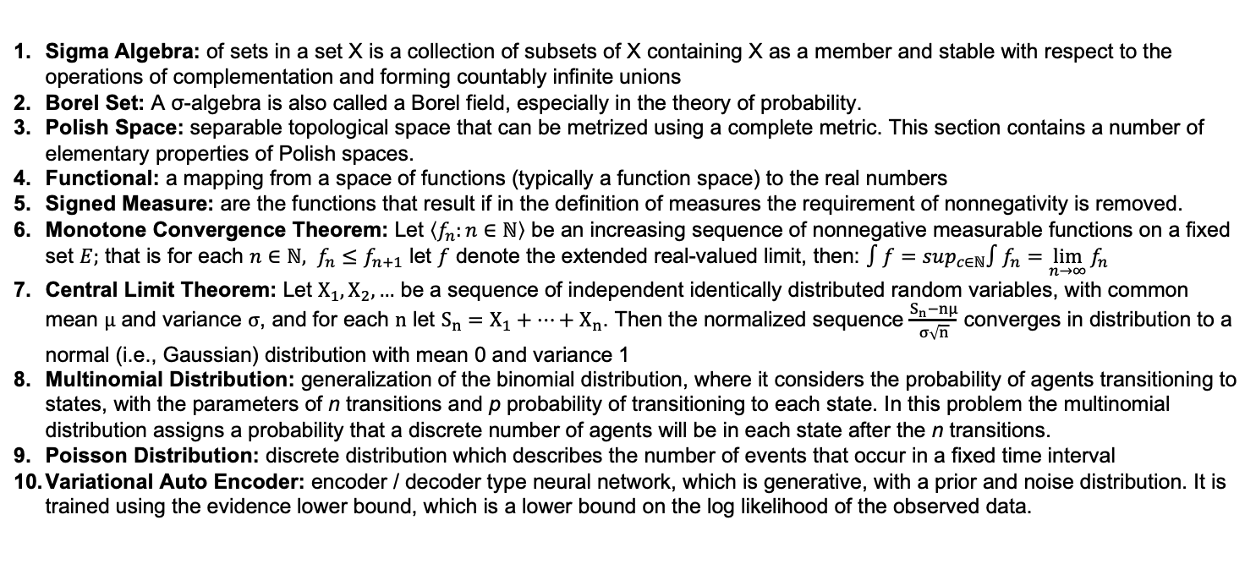
Reference Terms
Sigma Algebra: of sets in a set X is a collection of subsets of X containing X as a member and stable with respect to the operations of complementation and forming countably infinite unions
Borel Set: A σ-algebra is also called a Borel field, especially in the theory of probability.
Polish Space: separable topological space that can be metrized using a complete metric. This section contains a number of elementary properties of Polish spaces.
Functional: a mapping from a space of functions (typically a function space) to the real numbers
Signed Measure: are the functions that result if in the definition of measures the requirement of nonnegativity is removed.
Monotone Convergence Theorem: Let $\left\langle f_{n}:n∈ℕ\right\rangle$ be an increasing sequence of nonnegative measurable functions on a fixed set $E;$ that is for each $n∈ℕ, f_{n}≤f_{n+1}$ let $f$ denote the extended real-valued limit, then: $∫f=sup_{c∈ℕ}∫f_{n}=\lim_{n→∞}{f_{n}}$
Central Limit Theorem: Let $X_{1},X_{2},…$ be a sequence of independent identically distributed random variables, with common mean $μ$ and variance $σ$, and for each $n$ let $S_{n}=X_{1}+…+X_{n}$. Then the normalized sequence $\frac{S_{n}−nμ}{σ\sqrt{n}}$ converges in distribution to a normal (i.e., Gaussian) distribution with mean 0 and variance 1
Multinomial Distribution: generalization of the binomial distribution, where it considers the probability of agents transitioning to states, with the parameters of n transitions and p probability of transitioning to each state. In this problem the multinomial distribution assigns a probability that a discrete number of agents will be in each state after the n transitions.
Poisson Distribution: discrete distribution which describes the number of events that occur in a fixed time interval
Variational Auto Encoder: encoder / decoder type neural network, which is generative, with a prior and noise distribution. It is trained using the evidence lower bound, which is a lower bound on the log likelihood of the observed data.
Loeb, P. A. (2000). Real analysis.
Cohn, D. L. (2013). Measure theory (2nd ed.). Birkhäuser.
Notes:
Multinomial example: models the probability of counts for each side of a k-sided die rolled n times.
The mean field method for stochastic optimization is a technique used to simplify complex, high-dimensional problems by approximating the system’s behavior with a simpler, lower-dimensional representation.
It is often applied in the context of probabilistic models, particularly when dealing with systems of interacting agents.
In this application we are able to drastically simplify the stochastic control problem (equation 11) by making maintenance decisions based on the average or mean behavior of agents or vehicles.
This simplification is necessary given the computational issues associated with making vehicle-specific recommendations for all states at all times. It is reasonable in this application given the uniformity of vehicles, operation profiles, and maintenance polices present in the Army.

Slide 15
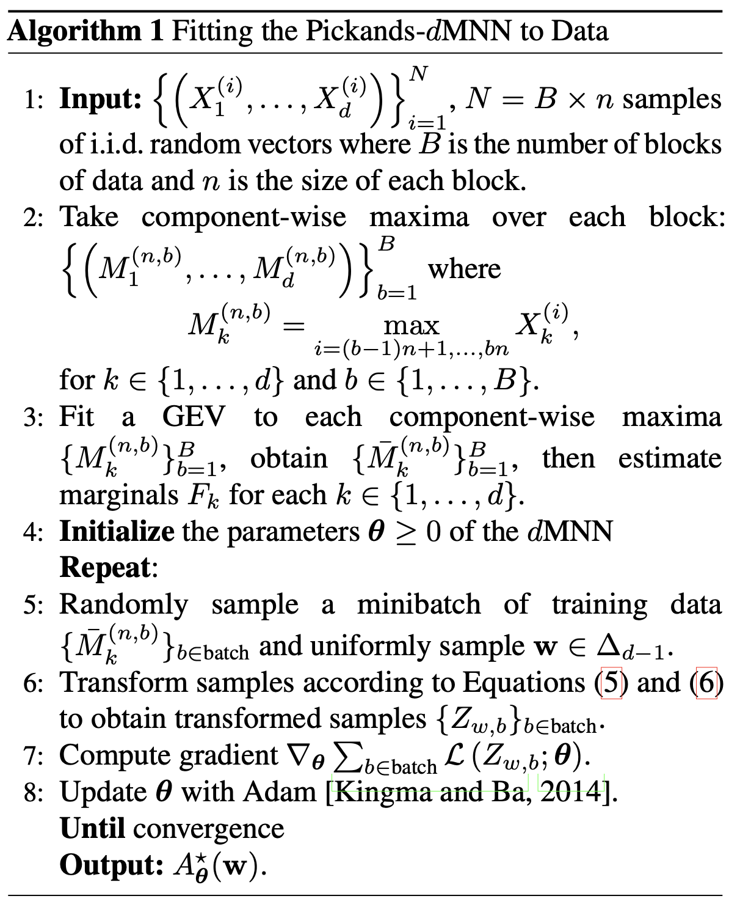

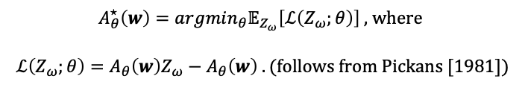

D-Max Decreasing Neural Network Pickands Representation¹
Pickands-dMNN Algorithm Definition
Pickands-dMNN Algorithm Details
$$F_{k}≔univariate marginal CDF, fit using MLE ∀k∈\{1, …,d\}.$$
$$w=\left(ω_{1}, …, ω_{d}\right)∈∆_{d−1}$$
${\overline{M}}_{k}^{(n)} =\frac{M_{k}^{(n)}−b_{k}^{(n)}}{ω_{k}}⟹{\tilde{M}}_{k}^{(n)}=$ $−\log\left(F_{k}({\overline{M}}_{k}^{(n)})\right), k∈\{1, …,d\}. (5)$
$$Z_{ω}=\min_{k=1,..,d}{\frac{{\tilde{M}}_{k}^{\left(n\right)}}{ω_{k}}. \left(6\right) ⟹ℙ\left[Z_{ω}>z\right]=exp⁡(−zA(w))}$$
$$we may now fit the model A_{θ}\left(w\right) to samples Z_{ω} using SGD$$
$A_{θ}^{⋆}\left(w\right)=argmin_{θ}𝔼_{Z_{ω}}\left[ℒ\left(Z_{ω};θ\right)\right] ,$ $where$
$$ℒ\left(Z_{ω};θ\right)=A_{θ}\left(w\right)Z_{ω}−A_{θ}\left(w\right) . (follows from Pickans [1981])$$
Hasan, A., Elkhalil, K., Ng, Y., Pereira, J. M., Farsiu, S., Blanchet, J., & Tarokh, V. (2022). Modeling extremes with dd-max-decreasing neural networks. In Proceedings of Uncertainty in Artificial Intelligence (pp. 759–768). PMLR.
Notes:
This is a deterministic characterization using the weights of the neural network, not allowing for probabilistic sampling, and proposed in the generative model.

Slide 16
Backup Slides

Slide 17
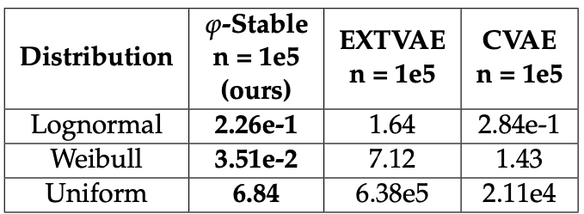
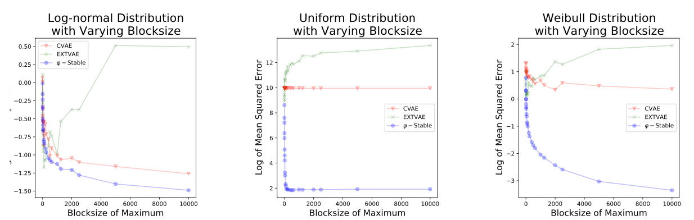

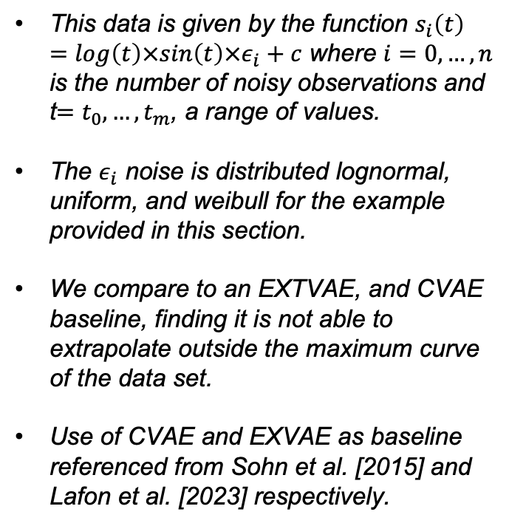


Synthetic Experiments
This data is given by the function $s_{i}\left(t\right)=log\left(t\right)×sin\left(t\right)×ε_{i}+c$ where $i=0, …,n$ is the number of noisy observations and t$=t_{0}, …,t_{m}$, a range of values.
The $ε_{i}$ noise is distributed lognormal, uniform, and weibull for the example provided in this section.
We compare to an EXTVAE, and CVAE baseline, finding it is not able to extrapolate outside the maximum curve of the data set.
Use of CVAE and EXVAE as baseline referenced from Sohn et al. [2015] and Lafon et al. [2023] respectively.
$$Lognormal$$
$$Uniform$$
$$Weibull$$
Notes:
So, we may now ask how well does this work on a simple example?
For an initial baseline experiment to assess the performance of the proposed method, we evaluate the $φ−$stable model’s ability to extrapolate accurately to the bounds of observed (training) data by constructing a set of observations calculated from a sinusoidal curve with a multiplicative noise component.
As a baseline we attempt to extrapolate to the maximum of the noisy sinusoidal curves with a conditional variational autoencoder or CVAE and an additional comparable method, designated as an extreme VAE, or EXTVAE.
Here in the CVAE the conditioning variable is based upon the $ℓ^{2}−$norm of each noisy training vectors. The EXTVAE does not have a conditioning variable but is designed to extrapolate to the ambient maximum of a data set, with no ability to extrapolate based on a context.
We formulated these baselines based on similar literature.
To evaluate each of the baseline methods and the proposed $φ−$stable model, we compare the mean squared error between each model’s generated curves and the true observed max in the noisy dataset, with increasing blocksize.
The results demonstrate that the $φ−$stable method consistently extrapolates to the ambient max, and demonstrates the appropriate performance as blocksize is increased. Specifically, the CVAE does not match the $φ−$stable method in performance and the EXTVAE demonstrates poor performance, with increasing error as blocksize in increased.
This out performance is true for all three of the noise distribution types considered: lognormal, uniform, and weibull.

